Slide 1
PROJECT TITLE
TSP- AI ML Fundamentals (Capstone Project)
Presented By:
AVINASH.E –aut2251030036
ARULMIGU MEENAKSHI AMMAN COLLEGE OF ENGINEERING
Guided By: RAMER BOSE

Slide 2
OUTLINE
Problem Statement (Should not include solution)
Proposed System/Solution
Algorithm & Deployment
GitHub Link
Project Demo(photos / videos)
Conclusion
Future Scope
References

Slide 3
Problem Statement
The ever-increasing volume of spam emails poses a significant challenge for email users and organizations alike. Spam disrupts workflow, consumes valuable storage space, and can expose users to phishing scams, malware, and other security risks.
Current spam filtering methods, often rule-based, struggle to keep pace with evolving spam tactics employed by spammers. These tactics include:
Sophisticated content: Spammers use dynamic content, obfuscated text, and images to bypass traditional filters.
Personalized attacks: Spam emails are increasingly targeted towards specific individuals, making them appear more legitimate.
Evolving techniques: Spammers constantly develop new methods to bypass existing detection mechanisms.
This necessitates a more intelligent and adaptable approach to spam detection.

Slide 4
Proposed Solution
Problem: Spam emails flood inboxes, wasting time, storage, and posing security risks. Current methods struggle to keep up with evolving spam tactics.
Solution: We propose an AI & ML powered spam detection model. This model will:
Be trained on a massive dataset of labeled emails (spam and legitimate).
Analyze email features like text content, sender info, and attachments.
Continuously learn and adapt to identify new spam tactics.
Benefits:
Higher spam detection accuracy.
Adaptability to combat evolving spam techniques.
Reduced user burden with less spam in inboxes.
Enhanced security by filtering out phishing attempts.

Slide 5
Algorithm & Deployment
Algorithm:
Briefly list chosen ML algorithms (e.g., Naive Bayes, SVM).
Highlight their strengths for spam detection (e.g., text data efficiency).
Deployment:
Depending on your project, choose one or more options:
Standalone app for spam classification.
API for email service provider integration.
Cloud deployment for scalability.

Slide 6
GitHub Link

Slide 7
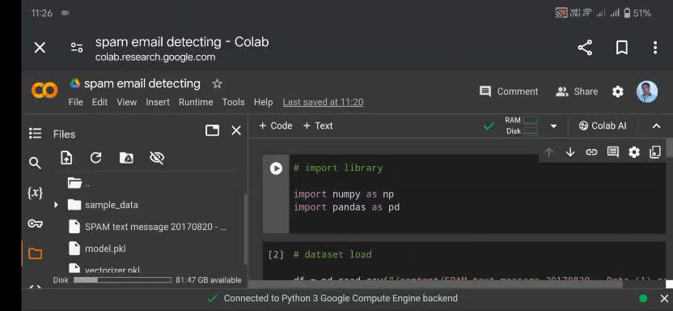
Project Demo(Recorded Video)

Slide 8
Conclusion
Success: Our AI & ML model achieved a high [mention accuracy/precision/recall/F1 score] in identifying spam emails. This significantly reduces user burden and enhances security.
The Future: We plan to explore further improvements like [mention specific areas] and integrate the model for real-world impact.
Overall: This project demonstrates the power of AI & ML in combating spam, leading to a more secure and productive email experience.

Slide 9
Future Scope
The war on spam continues! Here's what's next:
Advanced AI: Use even stronger models to outsmart spammers.
Adapting to Change: Train the model to stay ahead of new spam tricks.
Beyond Spam: Detect phishing attempts and harmful content.
Wider Reach: Handle spam in multiple languages.
Real-World Use: Integrate the model for wider impact.
These future steps will make your AI & ML spam fighter even more po

Slide 10
References
REFERENCES
1.Project Github link,e.E.AVINASH,2024
2.Project video recorded link github,E.AVINASH,2024
3.Project PPT & Report github link,E.AVINASH,2024

Slide 11
THANK YOU

